Slide 1
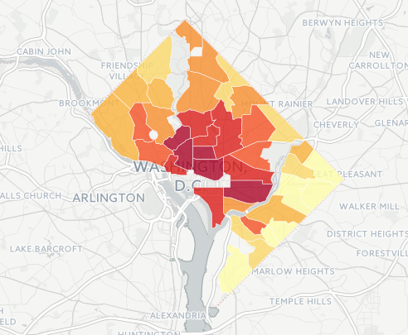
Visualizing DC’s Open Data
Source: DataLensDC
Open Data Day DC 2016
@datalensdc

Slide 2

What we’re covering
High level start to finish roadmap for data visualization when working with open data.
Select
Your Data
Transform
Your Data
Visualize
Your Data

Slide 3
Who am I?
I started DataLensDC (www.datalensdc.com / @datalensdc) last summer, a website that visualizes the trends and characteristics of the District. My work has been published in The Washingtonian, Washington City Paper, and The Atlantic’s CityLab, among other.

Slide 4
Also…
We have some really awesome TAs here to help you out today!

Slide 5
Where is Open Data?
Lots of places!
Mainly: data.gov (for federal data)
opendata.dc.gov (for District data)
But also District agency sites (like OSSE, WMATA), and non government actors.
Google ferociously and often.
Select Your Data
Transform Your Data
Visualize Your Data

Slide 6
Most Common Datatypes
CSV - comma separated values.
Most universally accepted data format, easily accessed in Excel and programming languages.
JSON/GeoJSON - javascript object notation
Data storage through name-value pairing. Common output from APIs, readable in all coding languages.
Just want a CSV? It’s easy! http://konklone.io/json/
PDF (not machine readable)
But there’s an app for that! http://tabula.technology/
Select Your Data
Transform Your Data
Visualize Your Data

Slide 7
Should I viz this data?
Visualizations require good data.
So consider the limitations of your data.
Select Your Data
Transform Your Data
Visualize Your Data

Slide 8
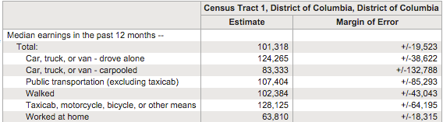
Should I viz this data?
How accurate are these estimations?
Margin of error shows the source’s confidence in it’s estimations. In this example:
Census is 90% confident the right number is between (estimate - margin of error) and (estimate + margin of error)
Source: Census American Community Survey
Select Your Data
Transform Your Data
Visualize Your Data

Slide 9
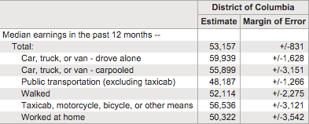
Should I viz this data?
How accurate are these estimations?
Generally, the margin of error decreases as the population size gets bigger. This may mean looking at a larger geography, a more general group of people or data collected over a larger time span.
Source: Census American Community Survey
Select Your Data
Transform Your Data
Visualize Your Data

Slide 10
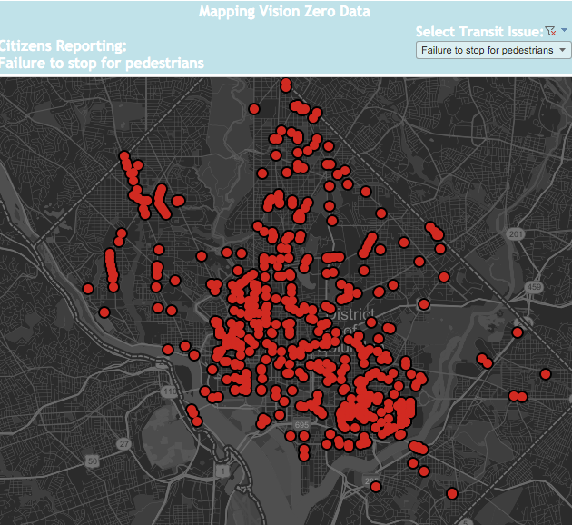
Should I viz
this data?
Is the data
representative of
the population?
The Vision Zero Safety
Map shows locations
people have self-
reported online as
hazardous.
Source: DataLensDC
Select Your Data
Transform Your Data
Visualize Your Data

Slide 11
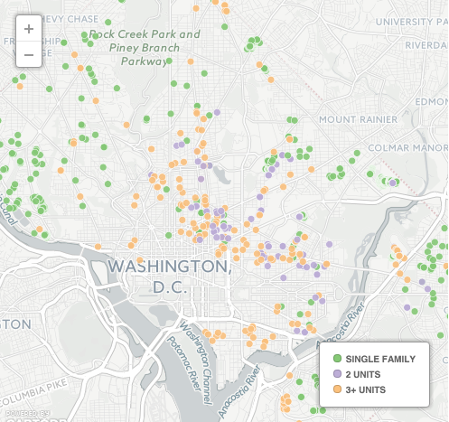
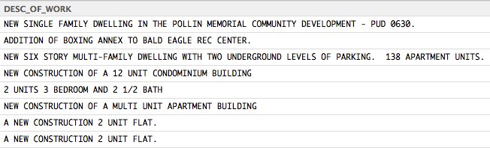
Common Data Transformations
Permits for New Residential Buildings,
January 2012- January 2016
Text analysis.
Messy open text fields sometimes hold valuable information.
Source: DataLensDC
You can check out the full code behind this here.
Transform Your Data
Transform Your Data
Visualize Your Data
Select Your Data
Visualize Your Data
Select Your Data

Slide 12
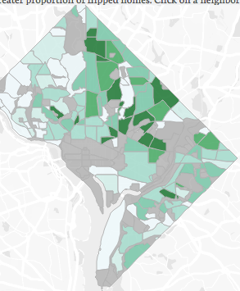
Common Data Transformations
Flipped Homes as % of Homes on Market,
by Neighborhood
2013-2015
Neighborhood Assignment.
Geolocating an address and then using the resulting latitude and longitude to place that location in a geographic area - ward, zip code, neighborhood, etc.
Source: DataLensDC
You can check out the full code behind this here.
Select Your Data
Transform Your Data
Visualize Your Data

Slide 13
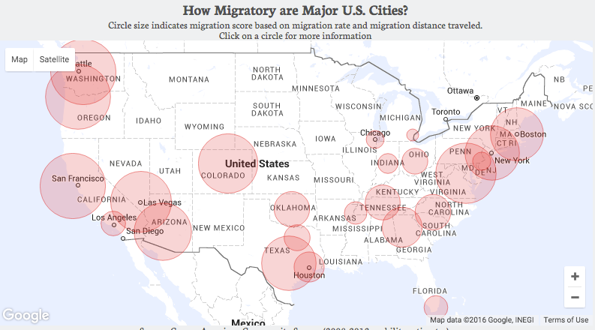
Common Data Transformations
All the little (un)
glamorous bits.
There is often data
cleaning to do - numeric fields with commas
stored as text, checks for duplicates, and more.
Source: DataLensDC
You can check out the full code behind this here.
Select Your Data
Transform Your Data
Visualize Your Data

Slide 14
Commonly Used Data Analysis Tools + Learning Resources
R
Python
Other
Advanced R
by Hadley Wickham
Swirl. Learn R in R
Learn Python the Hard Way
Learnpython.org
SAS
SPSS
Stata
MatLab
Julia
Excel
…
Resources for R, Python, and More
datacamp.com codeschool.com
udemy.com kaggle.com
codeacademy.com coursera.org
lynda.com (free through DC public library)
Select Your Data
Transform Your Data
Visualize Your Data

Slide 15








Active DC Data Community
Select Your Data
Transform Your Data
Visualize Your Data

Slide 16
Many Data Viz Tools to Choose From
Point and Click
Statistical Programming
JavaScript
Tableau
R
D3
Mapping
CartoDB, Leaflet
Mapbox
Select Your Data
Transform Your Data
Visualize Your Data

Slide 17

Many Data Viz Tools to Choose From
Statistical Programming
Point & Click
JavaScript
Tableau
R
D3
Of all tools, point and click is the easiest to learn if no prior programming experience
Creates fast and malleable data viz via drag and drop
Provides a wide range of built-ins but not fully flexible, more bespoke viz styles may not be possible or involve a difficult series of “hacks”
Select Your Data
Transform Your Data
Visualize Your Data

Slide 18
Many Data Viz Tools to Choose From
Statistical Programming
Point & Click
JavaScript
Tableau
R
D3
If new to R, then steeper learning curve. Best route only if previously familiar with specific programming language
Greater flexible through programmatic chart design
Limited ability to create interactive data viz
Select Your Data
Transform Your Data
Visualize Your Data

Slide 19
Many Data Viz Tools to Choose From
Statistical Programming
Point & Click
JavaScript
Tableau
R
D3
Steep learning curve, challenging even to those with front end experience
Extremely flexible in design
Most of the interactive data visualization you see at the NY Times or Washington Post was created D3
Select Your Data
Transform Your Data
Visualize Your Data

Slide 20
Many Data Viz Tools to Choose From
Mapping
CartoDB, Leaflet, MapBox
Most data visualization tools have mapping, but some tools are mapping specific and very in-depth
May provide geo-location and well stylized / customized basemaps
CartoDB and MapBox both have point and click as well as Javascript capabilities. Leaflet is a Javascript language.
Select Your Data
Transform Your Data
Visualize Your Data

Slide 21
Let’s Viz Some Data!
A CartoDB Breakout
www.cartodb.com
For future reference this Guide to CartoDB from a
recent MaptimeDC event is great.
Select Your Data
Transform Your Data
Visualize Your Data

Slide 22
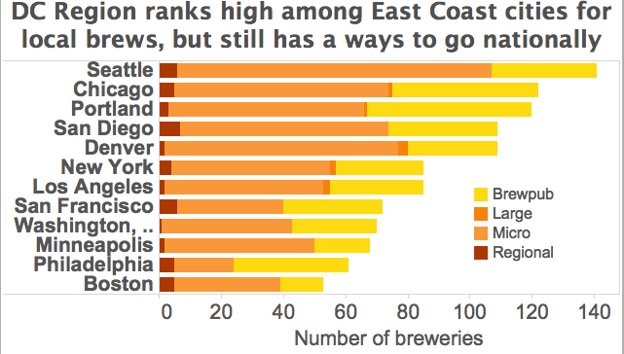
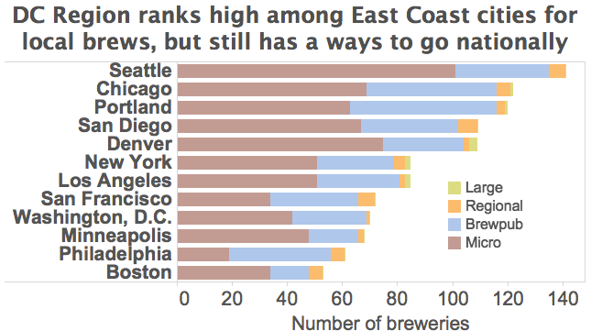
Color Matters
BAD
BETTER
Source: DataLensDC
Source: DataLensDC
At it’s worst color can repeal or confuse the reader. At it’s best color can draw the reader in and help tell the story.
Select Your Data
Transform Your Data
Visualize Your Data

Slide 23
Color Matters
Use different colors for different categories (qualitative), but not different values across a range (quantitative).
But never more than six colors.
Be mindful of color blindness.
For multiple graphs, a connected color scheme.
When in doubt, use ColorBrewer2 at colorbrewer2.org
Select Your Data
Transform Your Data
Visualize Your Data

Slide 24
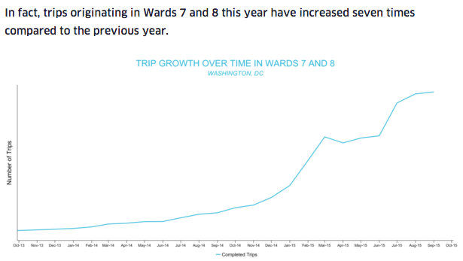
Label Well and Often
Labeling can occasionally be overlooked when focusing on the content of the graph, but are crucial for readers to get the facts
Lack of proper
labeling can confuse
or mislead, forcing
the reader to guess
of do “visual math.”
Source: Uber
Select Your Data
Transform Your Data
Visualize Your Data

Slide 25
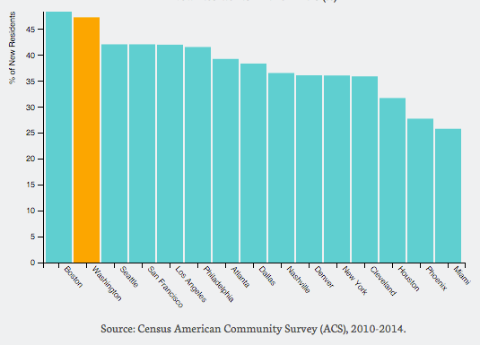
Titles To Tell Stories
Bad Title: New Residents aged 20-29 (%)
Better Title: Nearly Half of New DC Residents in their 20s
Select Your Data
Transform Your Data
Visualize Your Data

Slide 26
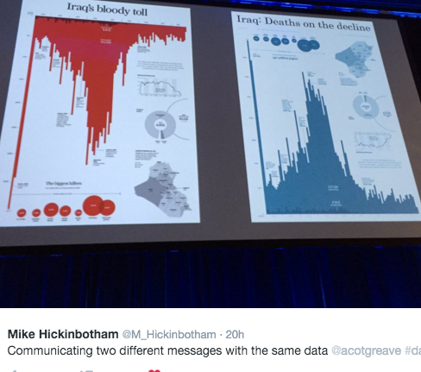
Same Data, Different Story
Select Your Data
Transform Your Data
Visualize Your Data

Slide 27
Let’s Viz Some Data!
A Tableau Breakout
To get started:
https://public.tableau.com/s/download
For future reference Tableau has a ton of free
learning resources and a very active community
Select Your Data
Transform Your Data
Visualize Your Data

Slide 28

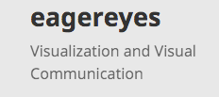






Awesome Blogs about Data Viz
Select Your Data
Transform Your Data
Visualize Your Data

